Slide 1
LOAN MANAGENT SYSTEM
R.B.NIZAR

Slide 2
MYSQL(Structured Query Language)
MySQL and SQL Explained
1. MySQL
MySQL is an open-source relational database management system (RDBMS) that is used to store, manage,and retrieve data efficiently.
It is based on the SQL (Structured Query Language)
and is widely used for web applications, enterprise applications, and cloud services.
Developed by Oracle Corporation
Commonly used with PHP, Python, Java, and other programming languages
Used in popular applications like WordPress, Facebook, and Netflix
2. SQL (Structured Query Language)
SQL is the standard language for managing databases. It is used to:
Create and modify database structures (CREATE, ALTER, DROP)
Insert, update, and delete data (INSERT, UPDATE, DELETE)
Retrieve data (SELECT)
Control access to data (GRANT, REVOKE)
MySQL vs. SQL
SQL is a language for managing databases.
MySQL is a software (RDBMS) that implements SQL for storing and managing data.

Slide 3
Sql server
SQL Server is generally used as a database in medium-sized companies and large enterprises, where the ability to scale to millions or hundreds of millions of records is important. SQL Server editions range from SQL Server Enterprise, designed with high-end datacenter capabilities, to SQL Server Express, an entry-level database for learning about and building desktop and small applications
Key features of sql servers:
✔ Relational Database Management – Organizes data in tables, using relationships. ✔ ACID Compliance – Ensures reliable transactions (Atomicity, Consistency, Isolation, Durability). ✔ Scalability & Performance – Optimized for large-scale data handling. ✔ Security – Supports encryption, authentication, and role-based access. ✔ Business Intelligence (BI) & Analytics – Integrates with Microsoft Power BI and Reporting Services. ✔ Cloud & On-Premise Support – Works with Azure SQL Database and traditional servers.

Slide 4
History of SQl
First developed in 1970s by two scientists at IBM following a theory of ‘relational algebra’ by Edgar F. Codd, who was also an IBM scientist.
First commercial implementation of SQL-based RDMBS was Oracle’s V2.
First adopted by ANSI in 1986, and ISO in 1987 as standard.
The latest version of the SQL standard is from 2016. There have been very many versions in between.

Slide 5
Most Important SQL Statements
SELECT - extracts data from a database (DQL)
UPDATE - updates data in a database (DML)
DELETE - deletes data from a database (DML)
INSERT - inserts new data into a database (DML)
CREATE DATABASE - creates a new database (DDL)
CREATE TABLE - creates a new table (DDL)
DROP TABLE - deletes a table (DDL)

Slide 6
Functions Used in this SQL
COUNT()
MIN()
MAX()
AVG()
SUM()
REPLACE()

Slide 7
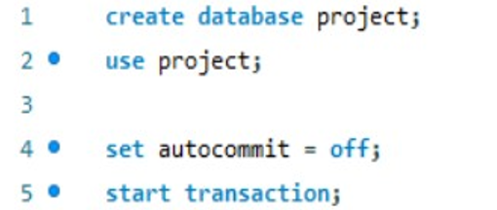
Creating database: descripstion:
Creating database as “project” to
Use the database and after
Set the auto cmmit to “off” the perform
The rollback and then start and
execute transaction

Slide 8
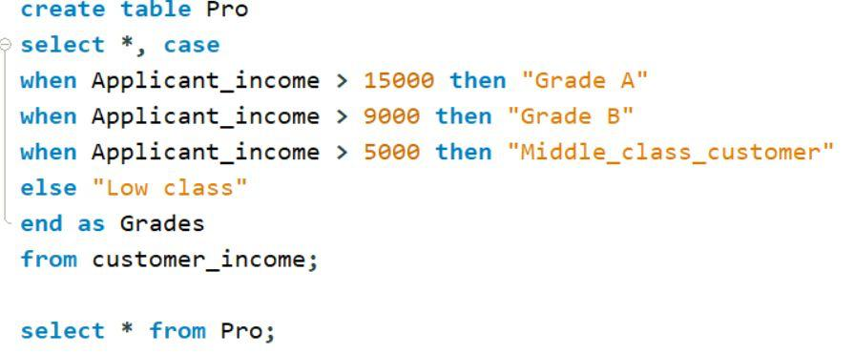
Code to set criteria:

Slide 9
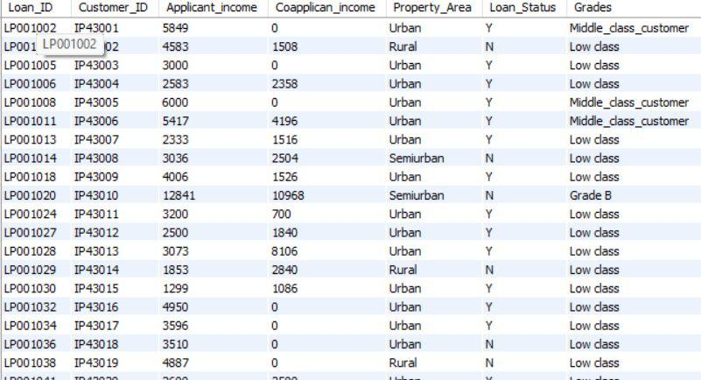
Table-1 “pro”

Slide 10
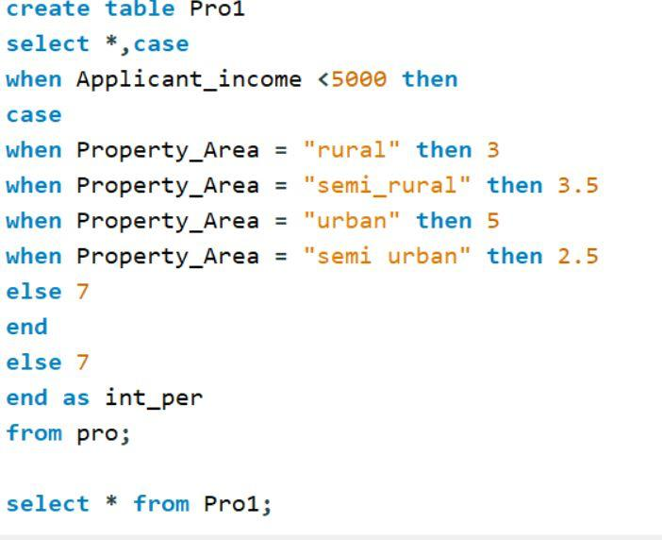
Code to Set Criteria

Slide 11
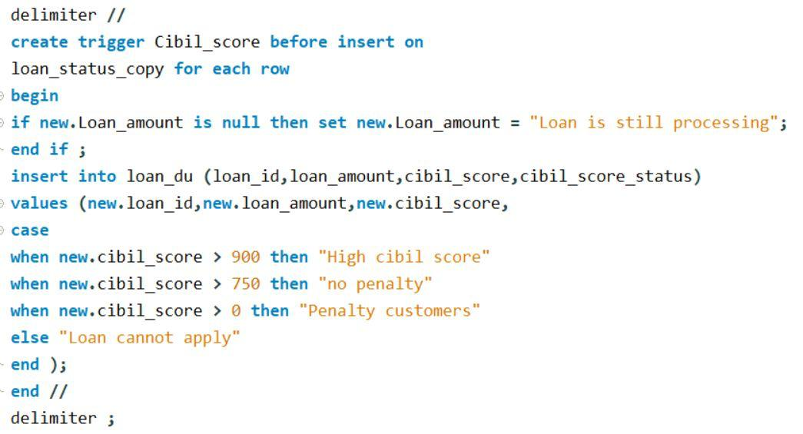
Creating Row Level Trigger and Statement level Trigger

Slide 12
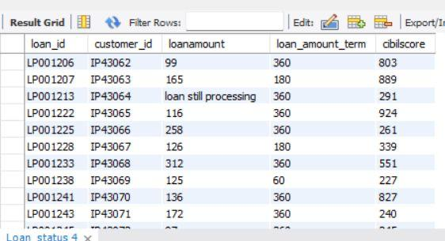
Loan still Processing Customers

Slide 13
Deleting the customers who’s application and loan amount are not processed

Slide 14
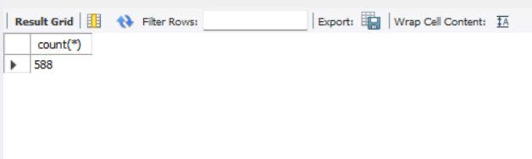
After Deleting the Customers the total Number of Customers are:

Slide 15
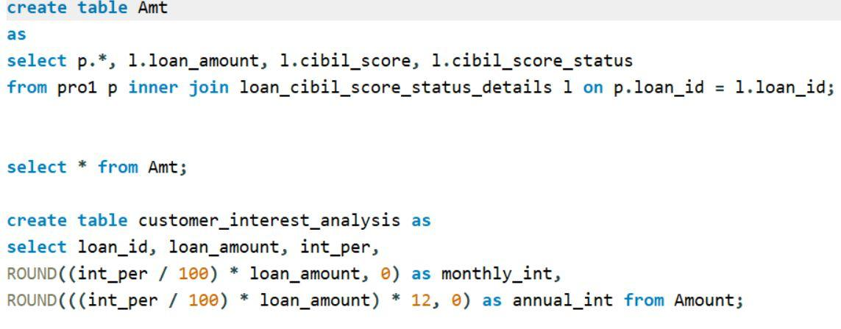
Annual and Monthly Interest Calculation

Slide 16
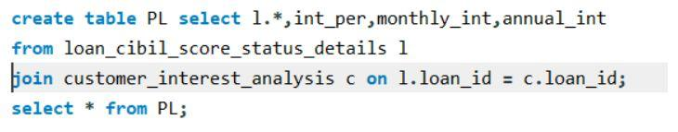
Join Tables

Slide 17
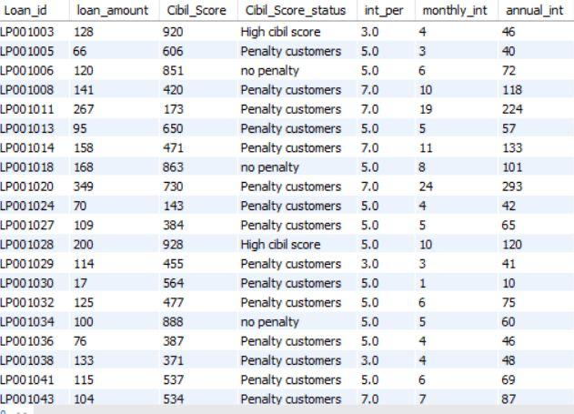
Output for Join Tables

Slide 18
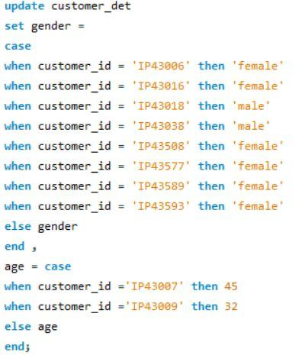
Updating the Gender and age of Customers

Slide 19
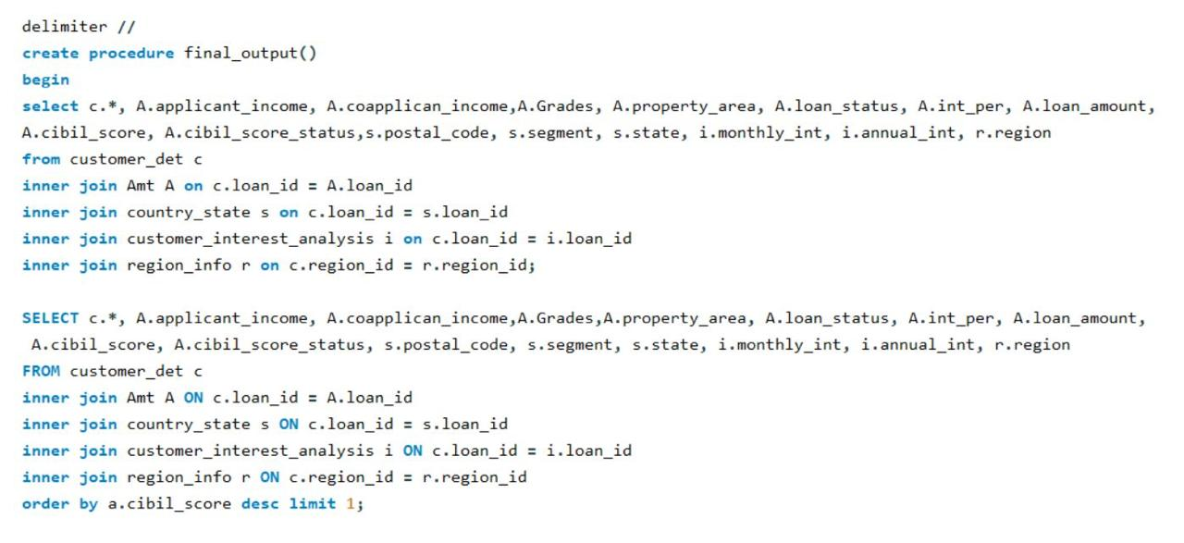
Create a Procedure called Final output and Include all Join Queries Together

Slide 20
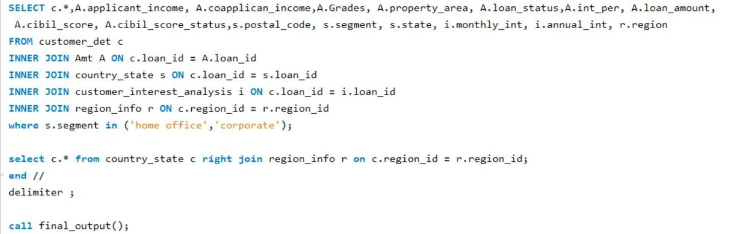
Ending the procedure using delimiter

Slide 21
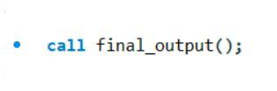
Calling procedure for all output

Slide 22
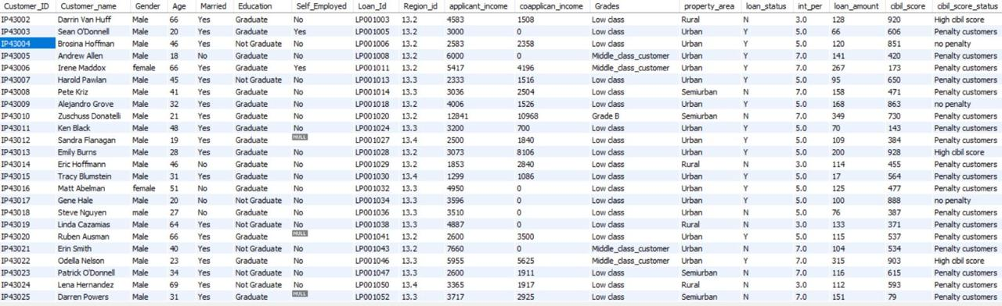
Output-1

Slide 23
Output-2

Slide 24
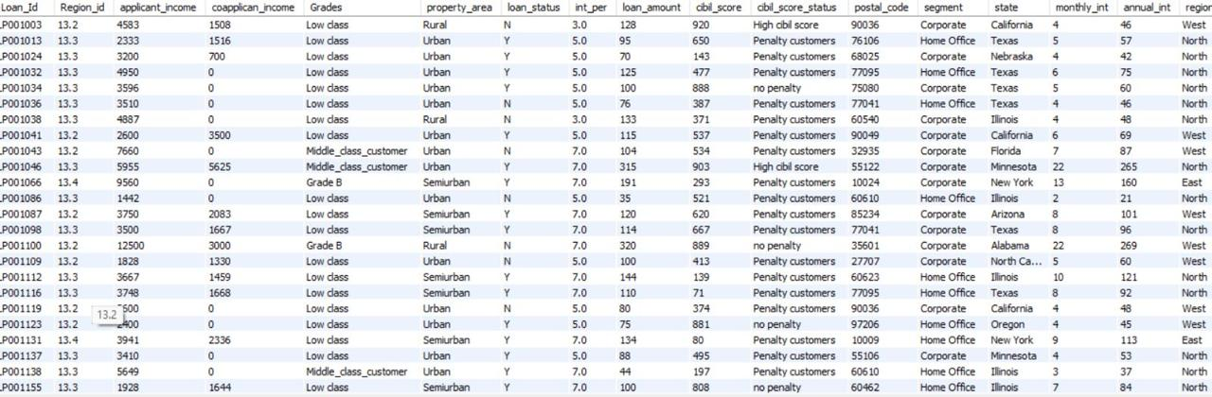
Output 3

Slide 25
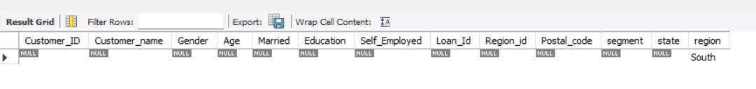
Output-4

Slide 26
THANK YOU….

